Slide 1
Software Carpentry
When you arrive…
Please fill in the pre-assessment workshop survey if you haven’t already
https://goo.gl/ZnUs6X
Go to the shared Etherpad, follow the set up instructions
https://goo.gl/miobce

Slide 2
Software Carpentry
Southampton
April 12-13 2018
Chris Cave-Ayland, Steve Crouch, James Graham, Alice Harpole, Sam Mangham, Tomás Muller-Bravo, John Robinson
@SWCarpentry @RSGSoton
Notes:
Been involved with Software Carpentry since 2012
Taught at 12 Software Carpentry workshops
And also train up new instructors for Software and Data Carpentry
1

Slide 3
Housekeeping
No fire drills today!
Evacuation route: Leave room via rear exit, turn right, go downstairs. Assemble in car park.
Toilets: Rear exit into corridor
Female → Left
Male → Right

Slide 4
Who are we and why are we here?
Notes:
1

Slide 5
Researchers who write software!
Whose main job isn’t producing code/software?
Who writes software to support research?
Who would find it impractical or impossible to do their main job without writing software?
Notes:
So writing software is important in what we do…
It’s a means to an end – e.g. doing research, gettting result to publish.
But so is the practice of doing ‘science’!
We do science to get a result, publish that.
So why is it that the practice of developing software
isn’t given the same attention as the practice of ‘science’?
In pharmacology, have strict protocols to follow in the lab.
Why not with developing software?
They both produce results, doesn’t software deserve the same attention?
1

Slide 6
We should care about software!
100%
92%
69%
50%
56%
0%
Use software
Fundamental to results
Develop own code
Source: Software Sustainability Institute Survey 2014
Notes:
And we should care about the software that underpins research!
From survey conducted by SSI of researchers at 15 Russell Group universities in 2014,
To find out about their software use and background.
Perhaps 220,000 researchers in the UK…
417 respondents. Whilst
- 92% of researchers said they use software in their research,
- and 69% that it’s fundamental to their results,
- and over half of their time is spent developing code,
90% have learned software development skills themselves.
That’s potentially a lot of people writing code!
That code generates results!
Results go into papers!
Papers are important!
Ergo, software is important!
1

Slide 7
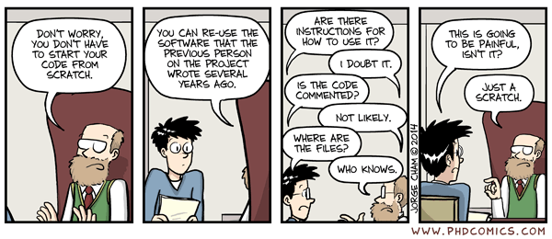
We should care about software!
We want to set you on the road to writing Sustainable Software
Notes:
And we should care about the software that underpins research!
From survey conducted by SSI of researchers at 15 Russell Group universities in 2014,
To find out about their software use and background.
Perhaps 220,000 researchers in the UK…
417 respondents. Whilst
- 92% of researchers said they use software in their research,
- and 69% that it’s fundamental to their results,
- and over half of their time is spent developing code,
90% have learned software development skills themselves.
That’s potentially a lot of people writing code!
That code generates results!
Results go into papers!
Papers are important!
Ergo, software is important!
1

Slide 8
We should care about software!
The take-home message is:
(This is the Software Sustainability Institute motto and I stole it)
Notes:
And we should care about the software that underpins research!
From survey conducted by SSI of researchers at 15 Russell Group universities in 2014,
To find out about their software use and background.
Perhaps 220,000 researchers in the UK…
417 respondents. Whilst
- 92% of researchers said they use software in their research,
- and 69% that it’s fundamental to their results,
- and over half of their time is spent developing code,
90% have learned software development skills themselves.
That’s potentially a lot of people writing code!
That code generates results!
Results go into papers!
Papers are important!
Ergo, software is important!
1

Slide 9
We should care about software!
“Teaching researchers the computing skills they need to get more done in less time and with less pain”
27,000 + Researchers taught since 1998 in 35 Countries
Materials are freely reusable (CCA license)
Notes:
And we should care about the software that underpins research!
From survey conducted by SSI of researchers at 15 Russell Group universities in 2014,
To find out about their software use and background.
Perhaps 220,000 researchers in the UK…
417 respondents. Whilst
- 92% of researchers said they use software in their research,
- and 69% that it’s fundamental to their results,
- and over half of their time is spent developing code,
90% have learned software development skills themselves.
That’s potentially a lot of people writing code!
That code generates results!
Results go into papers!
Papers are important!
Ergo, software is important!
1

Slide 10
Who are we?
Notes:
1

Slide 11
To help you learninate…
Helpers Craig Rafter Elena Vataga Alvaro Perez Diaz | Instructors Alice Harpole James Graham Sam Mangham Tomás Muller-Bravo Chris Cave Ayland Steve Crouch John Robinson
Notes:
Josh, Ryan, Alice and Ian are from the Next Generation Computational Modelling Group.
1

Slide 12
Research Software Group
We help to improve software developed by researchers at Southampton
Provide skilled Research Software Engineers
Software development skills training
Led by Simon Hettrick & John Robinson
rsg-info@soton.ac.uk / @RSGSoton
http://rsg.soton.ac.uk
Notes:
RSG led by SH and JR,
Based in Electronics and Computer Science
We hire out our software engineers across the University
Any faculty, any discipline
You can hire us to help you!
1

Slide 13
Software Sustainability Institute
Cultivate world-class research with software
Notes:
At a national level…
Also help people improve their software and how they develop it,
and train others
Also assigned coordinator for SWC and DC in the UK
Also investigate issues related to software more generally...
- Run events to look into these issues
- Work in policy – recognition for Research Software Engineers
1

Slide 14
What are we going to learn?
Notes:
1

Slide 15
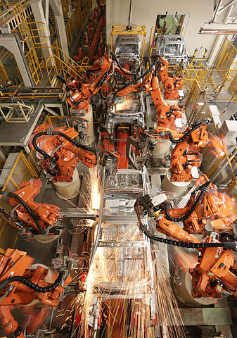
Automation
Bash Shell
Not just about learning commands
Learning just a few things can make a huge difference
Image Zen Wave
CC-BY-SA
Notes:
How to do repetitive tasks automatically…
Not just about learning commands:
Going to teach a basic working understanding of the shell
Core things like the filesystem, what happens you run a program
But… a few things:
Hard things that took hours become easy
[learner story]
Participant whose work was transformed by what they learnt they could do with Bash.
1

Slide 16
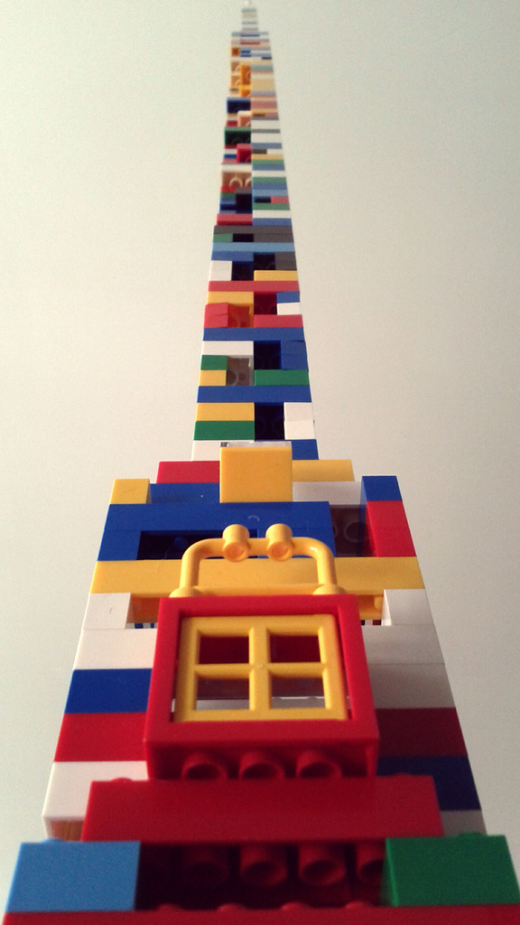
Python
Beyond syntax…
How to build programs step-by-step
Comprehensive, reusable, testable
Image Charles Kenny
CC-BY-SA
Notes:
A lot of the time you need more flexibility, granularity, control over processing
that the shell can’t really provide
Beyond syntax:
- Want to teach core skills you can apply after the workshop
- So teach by working example, not abstract lectures
Show how to build programs step-by-step:
- Going to use a basic climate modelling example based on real data
- Slowly build a program over time to process this data
As we go, teach how to build code that is
- Understandable (and reusable) by others
- Code comments, when and how to do it
- Modularity – as program grows, when and how do you start breaking down the
Program into separate functions and modules?
1

Slide 17
Version Control
Git
How has this code changed?
Who made this change?
Which version of this code was used to generate this result?
It’s the reproducibility, stupid
Notes:
A place to store and manage software code
Q: who here uses version control to develop software?
Avoid ‘dead laptop, lost code’ syndrome,
But it goes much further
It stores a complete history of software as it’s been developed over time
Can really help to overcome the situation commonly faced on the right...
Lightning talk at the Software Sustainabilty Institute’s annual CW earlier this year
- Andrew Walker
- Just one of many examples
- Did talk as message to his former self 10 years ago
- Along with modular design and automation -- version control!!!
- When you know it, and use it, you can’t live without it!
Real power is when you work as part of a team
- (Answering these questions…)
1

Slide 18
Agenda Day 1
10:00-12:30 Automating tasks with the Bash shell
Alice (Chris) 11:00-11:30 Break
12:30-13:30 Lunch
13:30-16:00 Building programs with Python I
James (Steve) 14:30-15:00 Break
16:00-16:30 Wrap-up
Notes:
1

Slide 19
Agenda Day 2
10:00-12:30 Building programs with Python II
Sam (Steve) 11:00-11:30 Break
12:30-13:30 Lunch
13:30-16:00 Version control with Git
Tomás (John) 14:30-15:00 Break
16:00-16:30 Wrap-up
Notes:
1

Slide 20
Some final words…
Notes:
<number>

Slide 21
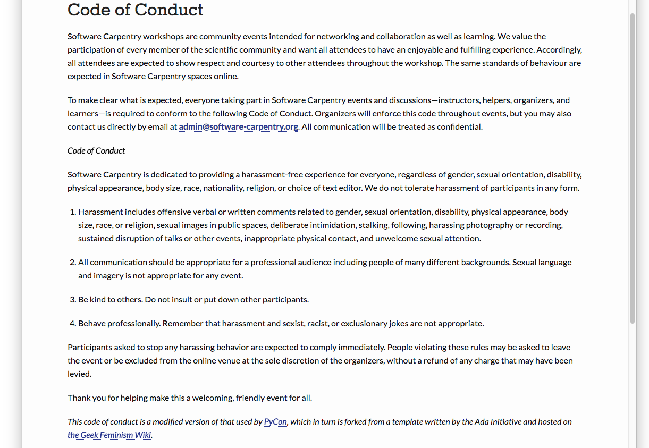
Code of Conduct
http://software-carpentry.org/conduct/
Notes:
Don’t harass people
Communicate appropriately
Be polite
Be a professional
<number>

Slide 22
Need help?
John Wiechecki
Say hi to your neighbours!
Notes:
<number>

Slide 23
Need help?
Michael Arrighi
Sticky notes

Slide 24
Need help?
Benjamin Reay
Ask the group in Etherpad
https://goo.gl/miobce
Notes:
<number>

Slide 25
That’s all from me…
…but for you, just the beginning!
Notes:
<number>

Slide 26
Software Carpentry Day 2
When you arrive…
Please check you can do the following…
Open the Python interpreter from a terminal, as we did yesterday, and type...
$ python
And type at the >>> prompt…
>>> import numpy
>>> import matplotlib
If you encounter any errors, please seek a helper to help you out

