Slide 1
Software Carpentry When you arrive…
Please fill in the pre-assessment workshop survey if you haven’t already
https://goo.gl/BJDtWY
Go to the shared Etherpad, follow the set up instructions
http://www.bit.ly/EtherAug17

Slide 2
Software Carpentry
Southampton
August 1-2 2017
Josh Greenhalgh, Steve Crouch, Priyanka Singh, John Robinson
Notes:
Been involved with Software Carpentry since 2012
Taught at 12 Software Carpentry workshops
And also train up new instructors for Software and Data Carpentry

Slide 3
Why are we here?

Slide 4
Researchers who write software!
Confess!
Who’s main job isn’t producing code/software?
Who writes software to support research?
Who would find it impractical or impossible to do their main job without writing software?
Notes:
So writing software is important in what we do…
It’s a means to an end – e.g. doing research, gettting result to publish.
But so is the practice of doing ‘science’!
We do science to get a result, publish that.
So why is it that the practice of developing software
isn’t given the same attention as the practice of ‘science’?
In pharmacology, have strict protocols to follow in the lab.
Why not with developing software?
They both produce results, doesn’t software deserve the same attention?

Slide 5
Ariane 5
$7 billion development, $500 million rocket
Used Ariane 4 code
Loss of guidance & altitude info
DLR German Aerospace Center; ESA/S. Corvaja
64-bit FP converted to to 16-bit signed integer
Notes:
The answer is yes, and here’s an example…
Didn’t properly test the code!

Slide 6
What’s missing?
“Three orders of magnitude in machine speed and three orders of magnitude in algorithmic speed add up to six orders of magnitude in solving power. A model that might have taken a year to solve 10 years ago can now solve in less than 30 seconds.”
– Bob Bixby, review of linear programming solvers from 1987-2002
Notes:
Published in 2012 perhaps gives us an inkling of what’s going on…
Million-fold increase in speed – impressive
But only hardware and algorithms –what’s missing is programming itself.
Time taken by majority of researchers to produce a new result is frequently
dominated by writing code, testing, debugging, installing, managing and maintaining software.
What you’ll learn over next two days will help you with these things.
We have a phrase on a project I work on…
Better Software
Better Research!

Slide 7
We should care about software!
100%
92%
69%
50%
56%
0%
Use software
Fundamental to results
Develop own code
Notes:
And we should care about the software that underpins research!
From survey conducted by SSI of researchers at 15 Russell Group universities in 2014,
To find out about their software use and background.
Perhaps 220,000 researchers in the UK…
417 respondents. Whilst
- 92% of researchers said they use software in their research,
- and 69% that it’s fundamental to their results,
- and over half of their time is spent developing code,
90% have learned software development skills themselves.
That’s potentially a lot of people writing code!
That code generates results!
Results go into papers!
Papers are important!
Ergo, software is important!

Slide 8
Housekeeping
No fire drills today!
Evacuation route
Directly out of main entrance
Assemble in paved area, bottom of steps
Toilets – exit room, around corner on left
Tea and coffee provided at breaks!

Slide 9
Who are we?

Slide 10
To help you learninate…
Instructors
Josh Greenhalgh*
Steve Crouch
Priyanka Singh
John Robinson
Helpers
Ryan Pepper*
Alice Harpole+
Ian Hawke*
* Next Generation Computational Modelling Group
+ Mathematics
Notes:
Josh, Ryan, Alice and Ian are from the Next Generation Computational Modelling Group.

Slide 11
Research Software Group
www.rsg.soton.ac.uk
Based in Electronics and Computer Science
We help to improve software developed by researchers at Southampton, through:
Direct collaboration: we provide skilled Research Software Engineers for projects
Software development skills training: through Software & Data Carpentry workshops
Led by Simon Hettrick & John Robinson
Contact
rsg-info@soton.ac.uk
Notes:
RSG led by SH and JR,
Based in Electronics and Computer Science
We hire out our software engineers across the University
Any faculty, any discipline
You can hire us to help you!

Slide 12
Software Sustainability Institute
Cultivate world-class research with software
Notes:
At a national level…
Also help people improve their software and how they develop it,
and train others
Also assigned coordinator for SWC and DC in the UK
Also investigate issues related to software more generally...
- Run events to look into these issues
- Work in policy – recognition for Research Software Engineers

Slide 13
What are we going to learn?

Slide 14
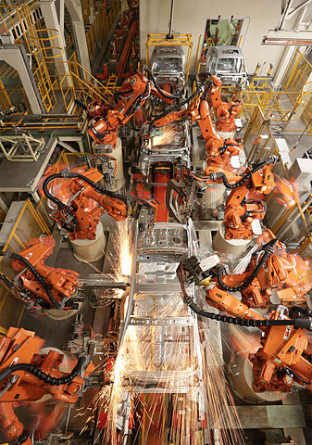
Automation
Bash Shell
Not just about learning commands
Learning just a few things can make a huge difference
Image Zen Wave CC-BY-SA
Notes:
How to do repetitive tasks automatically…
Not just about learning commands:
Going to teach a basic working understanding of the shell
Core things like the filesystem, what happens you run a program
But… a few things:
Hard things that took hours become easy
[learner story]
Participant whose work was transformed by what they learnt they could do with Bash.

Slide 15
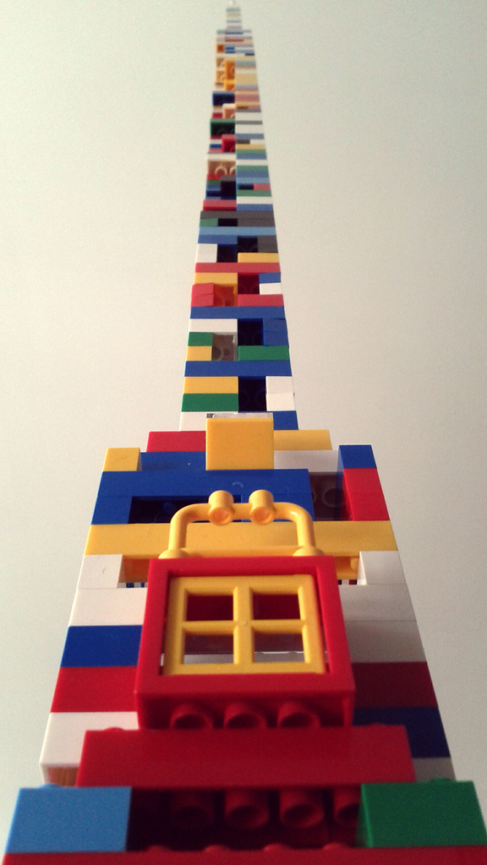
Python
Beyond syntax…
How to build programs step-by-step
Comprehensive, reusable, testable
Image Charles Kenny CC-BY-SA
Notes:
A lot of the time you need more flexibility, granularity, control over processing
that the shell can’t really provide
Beyond syntax:
- Want to teach core skills you can apply after the workshop
- So teach by working example, not abstract lectures
Show how to build programs step-by-step:
- Going to use a basic climate modelling example based on real data
- Slowly build a program over time to process this data
As we go, teach how to build code that is
- Understandable (and reusable) by others
- Code comments, when and how to do it
- Modularity – as program grows, when and how do you start breaking down the
Program into separate functions and modules?

Slide 16
Version Control
Git
How has this code changed?
Who made this change?
Which version of this code was used to generate this result?
Notes:
A place to store and manage software code
Q: who here uses version control to develop software?
Avoid ‘dead laptop, lost code’ syndrome,
But it goes much further
It stores a complete history of software as it’s been developed over time
Can really help to overcome the situation commonly faced on the right...
Lightning talk at the Software Sustainabilty Institute’s annual CW earlier this year
- Andrew Walker
- Just one of many examples
- Did talk as message to his former self 10 years ago
- Along with modular design and automation -- version control!!!
- When you know it, and use it, you can’t live without it!
Real power is when you work as part of a team
- (Answering these questions…)

Slide 17
Agenda
10:00-12:30 Automating tasks with the Bash shell
(Josh) 11:00-11:30 Break
12:30-13:30 Lunch
13:30-16:00 Building programs with Python I
(Steve) 14:30-15:00 Break
16:00-16:30 Wrap-up

Slide 18
Agenda
10:00-12:30 Building programs with Python II
(Priyanka) 11:00-11:30 Break
12:30-13:30 Lunch
13:30-16:00 Version control with Git
(John) 14:30-15:00 Break
16:00-16:30 Wrap-up

Slide 19
Some final words…

Slide 20
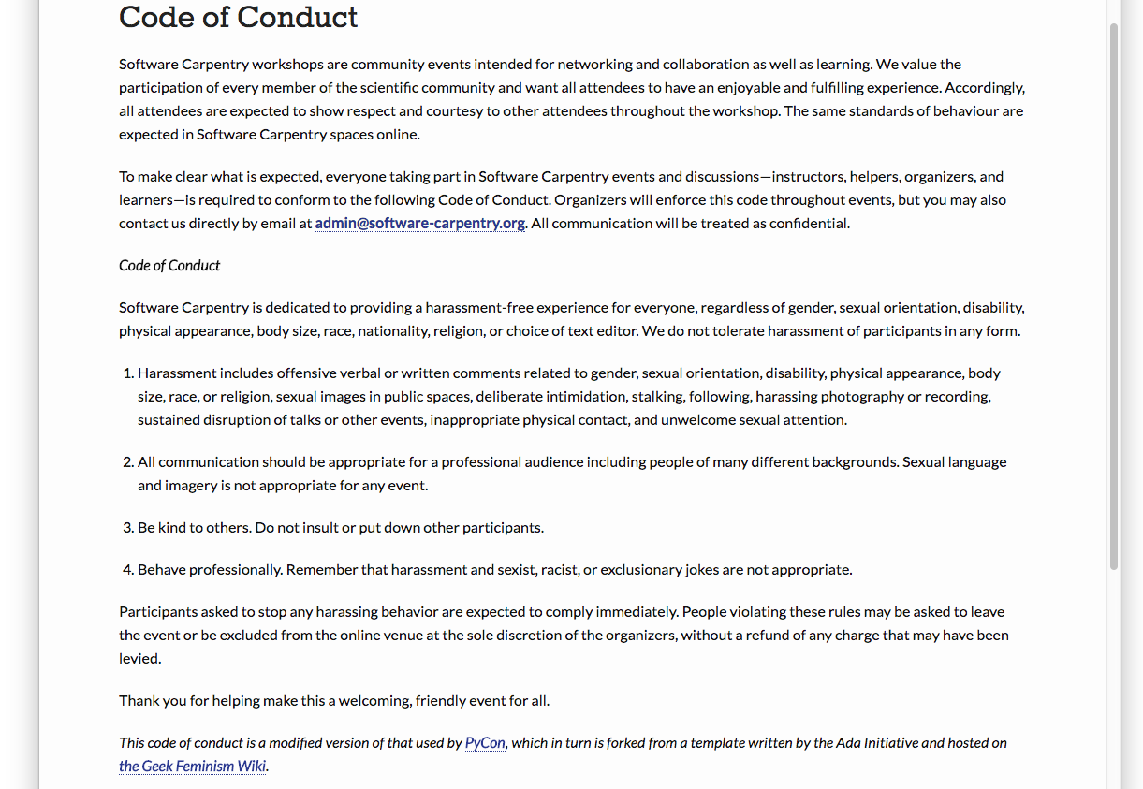
Code of Conduct
http://software-carpentry.org/conduct/
Notes:
Don’t harass people
Communicate appropriately
Be polite
Be a professional

Slide 21
Need help?
John Wiechecki
Say hi to your neighbours!

Slide 22
Need help?
Michael Arrighi
Sticky notes

Slide 23
Need help?
Benjamin Reay
Ask the group in Etherpad
http://bit.ly/EtherAug17

Slide 24
That’s all from me…
…but for you, just the beginning!

Slide 25
Software Carpentry Day 2 When you arrive…
Please check you can do the following…
Open the Python interpreter from a terminal, as we did yesterday, and type...
$ python
And type at the >>> prompt…
>>> import numpy
>>> import matplotlib
If you encounter any errors, please seek a helper to help you out

